Slide 1
OUR COMPANY WILL BE CALLED
ABSVETPRO

Slide 2
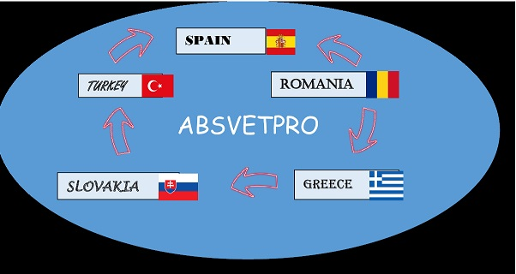
WE MUST CHOOSE THE LOGO THAT WILL REPRESENT US

Slide 3
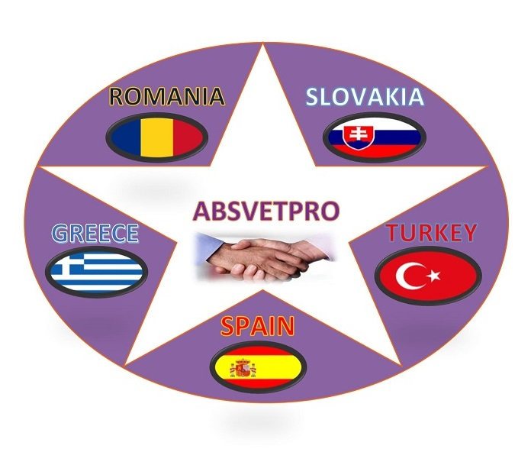
LOGOS

Slide 4
SLOVAKIA
ABSVETPRO
SPAIN
ROMANIA
TURKEY
GREECE

Slide 5
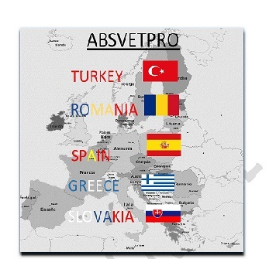

Slide 6
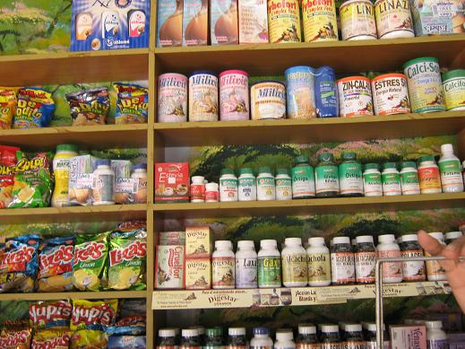
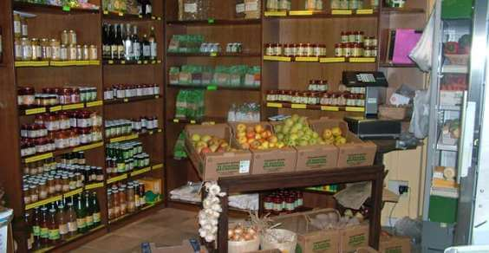
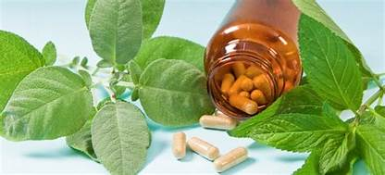
THE ACTIVITY TO WHICH OUR COMPANY WILL BE DEDICATED:
NATURAL HEALTH CENTRE SPECIALIZED IN NATURAL REMEDIES

Slide 7
WHY:
Because nowdays there are more people turning to alternative therapies. We now understand that when you take medicines to cure an illness, it can also cause other problems. So people look for complementary remedies which are generally made from natural ingredients.

Slide 8
WHAT DO PEOPLE DO NOW
People take complementary remedies which are generally made from natural ingredients. Or they want treatments that treat the whole body. In other words, holistic treatments.

Slide 9
WHERE ARE WE GOING TO TAKE OUR PRODUCTS
Our products will be related to homeopathy, acupuncture, osteopathy.
These alternative therapies have a motto and it is:
THE MIND IS EXTREMELY POWERFUL

Slide 10
OUR COMPANY WILL HAVE 7 DEPARTMENTS.
MARKETING-
One of the leading technologies in the market is the implementation of services, infrastructure and development platforms in the cloud.
Make a POWTOON, explaining what are the steps to create a company in your country.
Make FLYERS, making known the company, address, logo and some products.
Make POSTERS, poster to announce the company.
List of items with their photographs and prices
BUYING AND SELLING-
Place orders, delivery notes, invoices, both purchase and sale.
TREASURY-
It is responsible for managing the immediate liquidity of the cash and financial accounts of a company

Slide 11
OUR COMPANY WILL HAVE 7 DEPARTAMENTS.
HUMAN RESOURCES-
Interviews will be conducted with potential candidates to work, according to the professional profile.
Curriculum Vitae will be extended.
2 work contracts will be drawn up.
The first 2 payrolls will be made.
interviews will be conducted with potential candidates to work, according to the professional profile.
Curriculum Vitae will be extended
2 work contracts will be drawn up
The first 2 payrolls will be made
Make social insurance
FINANCIAL-
Perform accounting and compliance with the legal and fiscal requirements of the company.
ADMINISTRATION-
Register, process and transmit documents, invoices, emails and any other type of information.
Perform administrative procedures before the public administration, be responsible for submitting documents electronically in a timely manner, supervise compliance with deadlines in administrative procedures, etc.
Office event planning is also usually the responsibility of administrative assistants. The size of this responsibility may vary according to the size of the company.

Slide 12
OUR COMPANY WILL HAVE 7 DEPARTAMENTS.
WAREHOUSE-
In this department, the items purchased and the items sold will be entered.
The ratio be calculated
ABC
Analysis
Safety stock
Order point
Optimal order lot

Slide 13
HOW TO MAKE THE COMMUNICATIONS
Communications will be made through a business letter, video calls (one call every week), and email. Everything will be done in English.
Also, they have to do a POOTOWN, explaining the steps to create a company in your country.
The documents will be hosted in DRIVE. Each company will create a folder with the name of their country and keep all the documentation that is generated.

Slide 14
SOCIAL NETWORKS
All countries must advertise Erasmus on social networks through Facebook, Instagram and Twitter

Slide 15
INFORMATION
EVERYONE SHOULD SEND PHOTOGRAPHS, VIDEOS, OF ALL EVENTS, MEETINGS, DAYS TO BE MADE IN THEIR VET INSTITUTES, TO BE PUBLISHED ON THE WEB:
www.erasmusvet.eu

Slide 16
WHO WILL BE RESPONSIBLE?
Responsability of each partner:
Development of the creation of the Company.
Development of the task/activities of each department.
Make ITC resources. Using DRIVE, cloud…
Dissemination and use of social networks in your country and internationally, if possible.
If possible, in each international meeting, invite representants from the professional field.

Slide 17
HOW ARE WE GOING TO MEASURE THE RESULTS?
Using the web site.
Measuring the early leavers and the insertion of immigrants in our schools.
Measuring how many students exchanging we can get.
Making different resources about VET system.
Making digital resources as videos, brochures, flyers…

