Slide 1
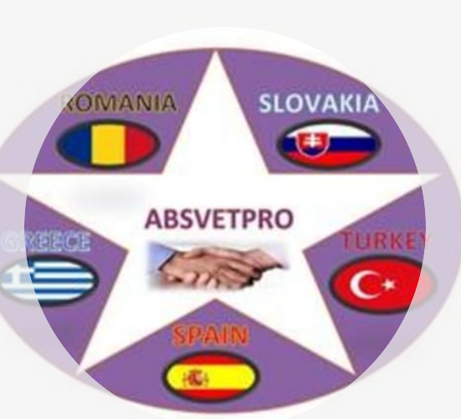
III INTERNATIONAL MEETING ONLINE FROM GREECE absvetpro

Slide 2
ROMANIA
WORDPRESS WITH A PLUGIN WOOCOMMERCE FOR THE ONLINE STORE.
If It is not possible, you can use other website for example WISH OR BLOGGER.
Link to Wordpress Manual. http://ernestogbustamante.com/aprender-wordpress-hacer-pagin
If you see that it's a lot of work or very difficult, there are You Tube looking on free websites with their own domain. https://www.youtube.com/watch?v=MFgZ5Vm-LU8

Slide 3
TURKEY
We have the executable program IS FINE. I HAVE UPLOADED THE VIDEO TO THE WEB BECAUSE THE PROGRAM CANNOT UPLOAD IT. IN THE PROGRAM I DON’T SEE IN THE PROGRAM the ABC Analysis, the Safety Stocks of each product and FINALLY, the optimal order batch, to minimize the costs, when the orders are placed…

Slide 4
GREECE
You have SENT ORDERS, invoiceS, AND DELIVERY NOTES.
. WE BELIEVE THAT WE COULD CONTINUE TO BUY AND SELL…

Slide 5
SPAIN
We have made all the company's discharge documents, always with Spanish documents. Every country will have its own.. We cannot pay or post as long as purchase and sales invoices BECAUSE THEY HAVE BEEN UPLOADED RECENTLY AND WE DID NOT REALIZE. WE ALSO HAVE TO MAKE THE COLLECTIONS AND PAYMENTS TO HAVE FUNDS
We have also prepared budgets for office supplies and computer equipment BUT They HAVE NOT YET BEEN uploaded to the web OR TO THE Drive.

Slide 6
Slovakia
WE CAN’T FIND THE PHOTOS WITH THE ROLL-UP.
WE DO NOT HAVE ANY PROJECT IMPLEMENTED IN THE VOCATIONAL TRAINING INSTITUTES OF YOUR COUNTRY.
EITHER Taxes you record in your country

Slide 7
VALUE ADDED TAX
We are interested in knowing how VAT is settled in each of your countries. Which seems to you if you each send me the settlement model and taxes according to the items. In the case of Turkey, there must be some similar tax that IT IS LEVIED ON consumption. Could you tell me what percentage and the document?

