Slide 1
LICEUL TEHNOLOGIC ”ELENA CARAGIANI”
,,Elena Caragiani” Technological High School

Slide 2
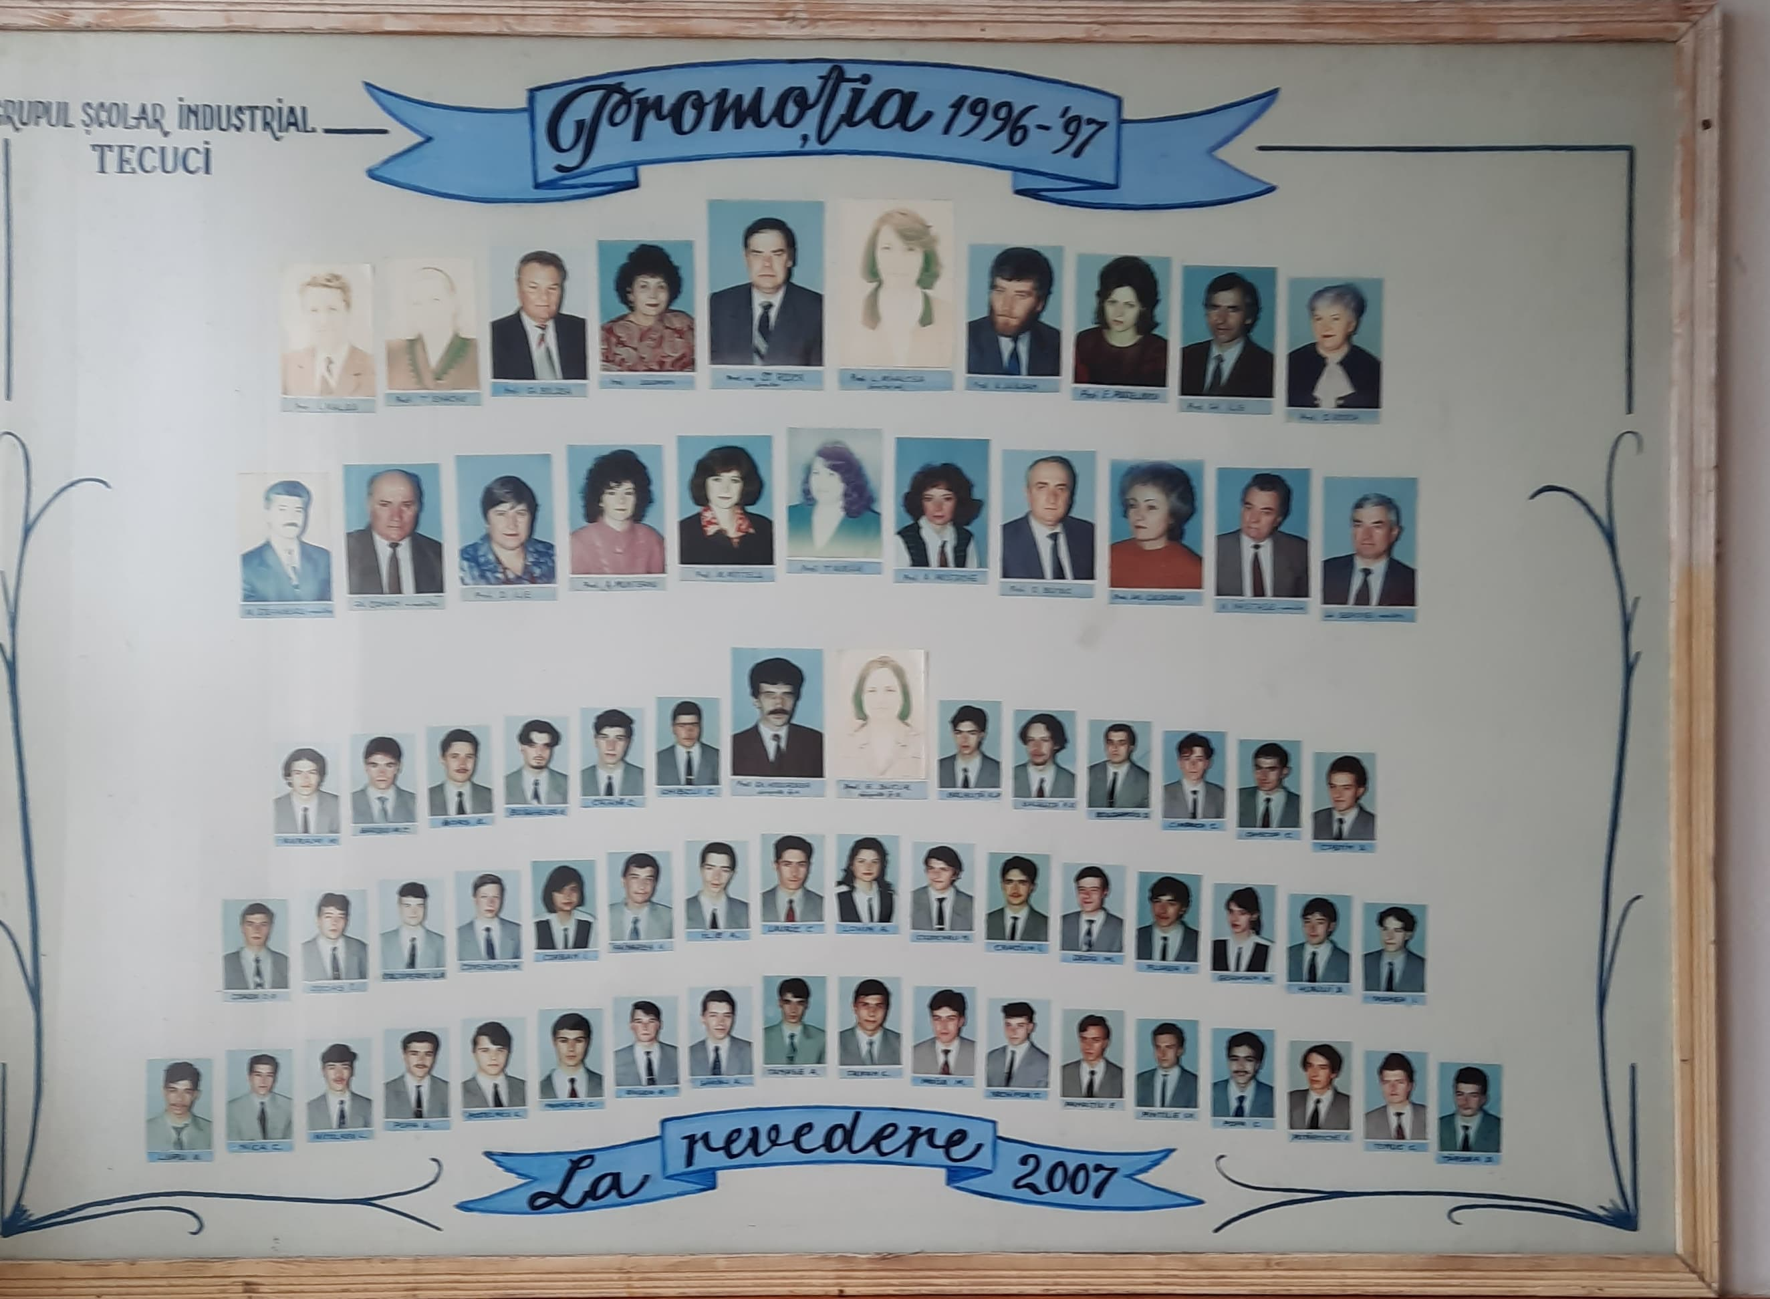
The story of the Elena Caragiani Technological High School begins on the 1st of September 1990, when “Gheorghe Asachi” School, Tecuci set up 6 apprentice classes. With these qualifications, in addition to 6 professional school qualifications (Vegetable preparer, Clothing, Car paint, Electrician maintenance, Welding and Locksmith), in the following school year, 1991-1992, the Professional School is formed. This school lasts for 2 years because on the 1st September 1993, 3 high school classes are established. It is the birth certificate of the “Industrial School Group”.

Slide 3
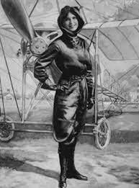
From the 1st of September 2012 the name of the school changes from the “Industrial School Group” to “Elena Caragiani” Technological High School.
Elena Caragiani was the first woman aviator of Romania and she was born in Tecuci. She dared to apply for a pilot’s patent in a century in which this right belonged almost exclusively to men. She was the world’s first journalist who wrote reports from the plane.

Slide 4
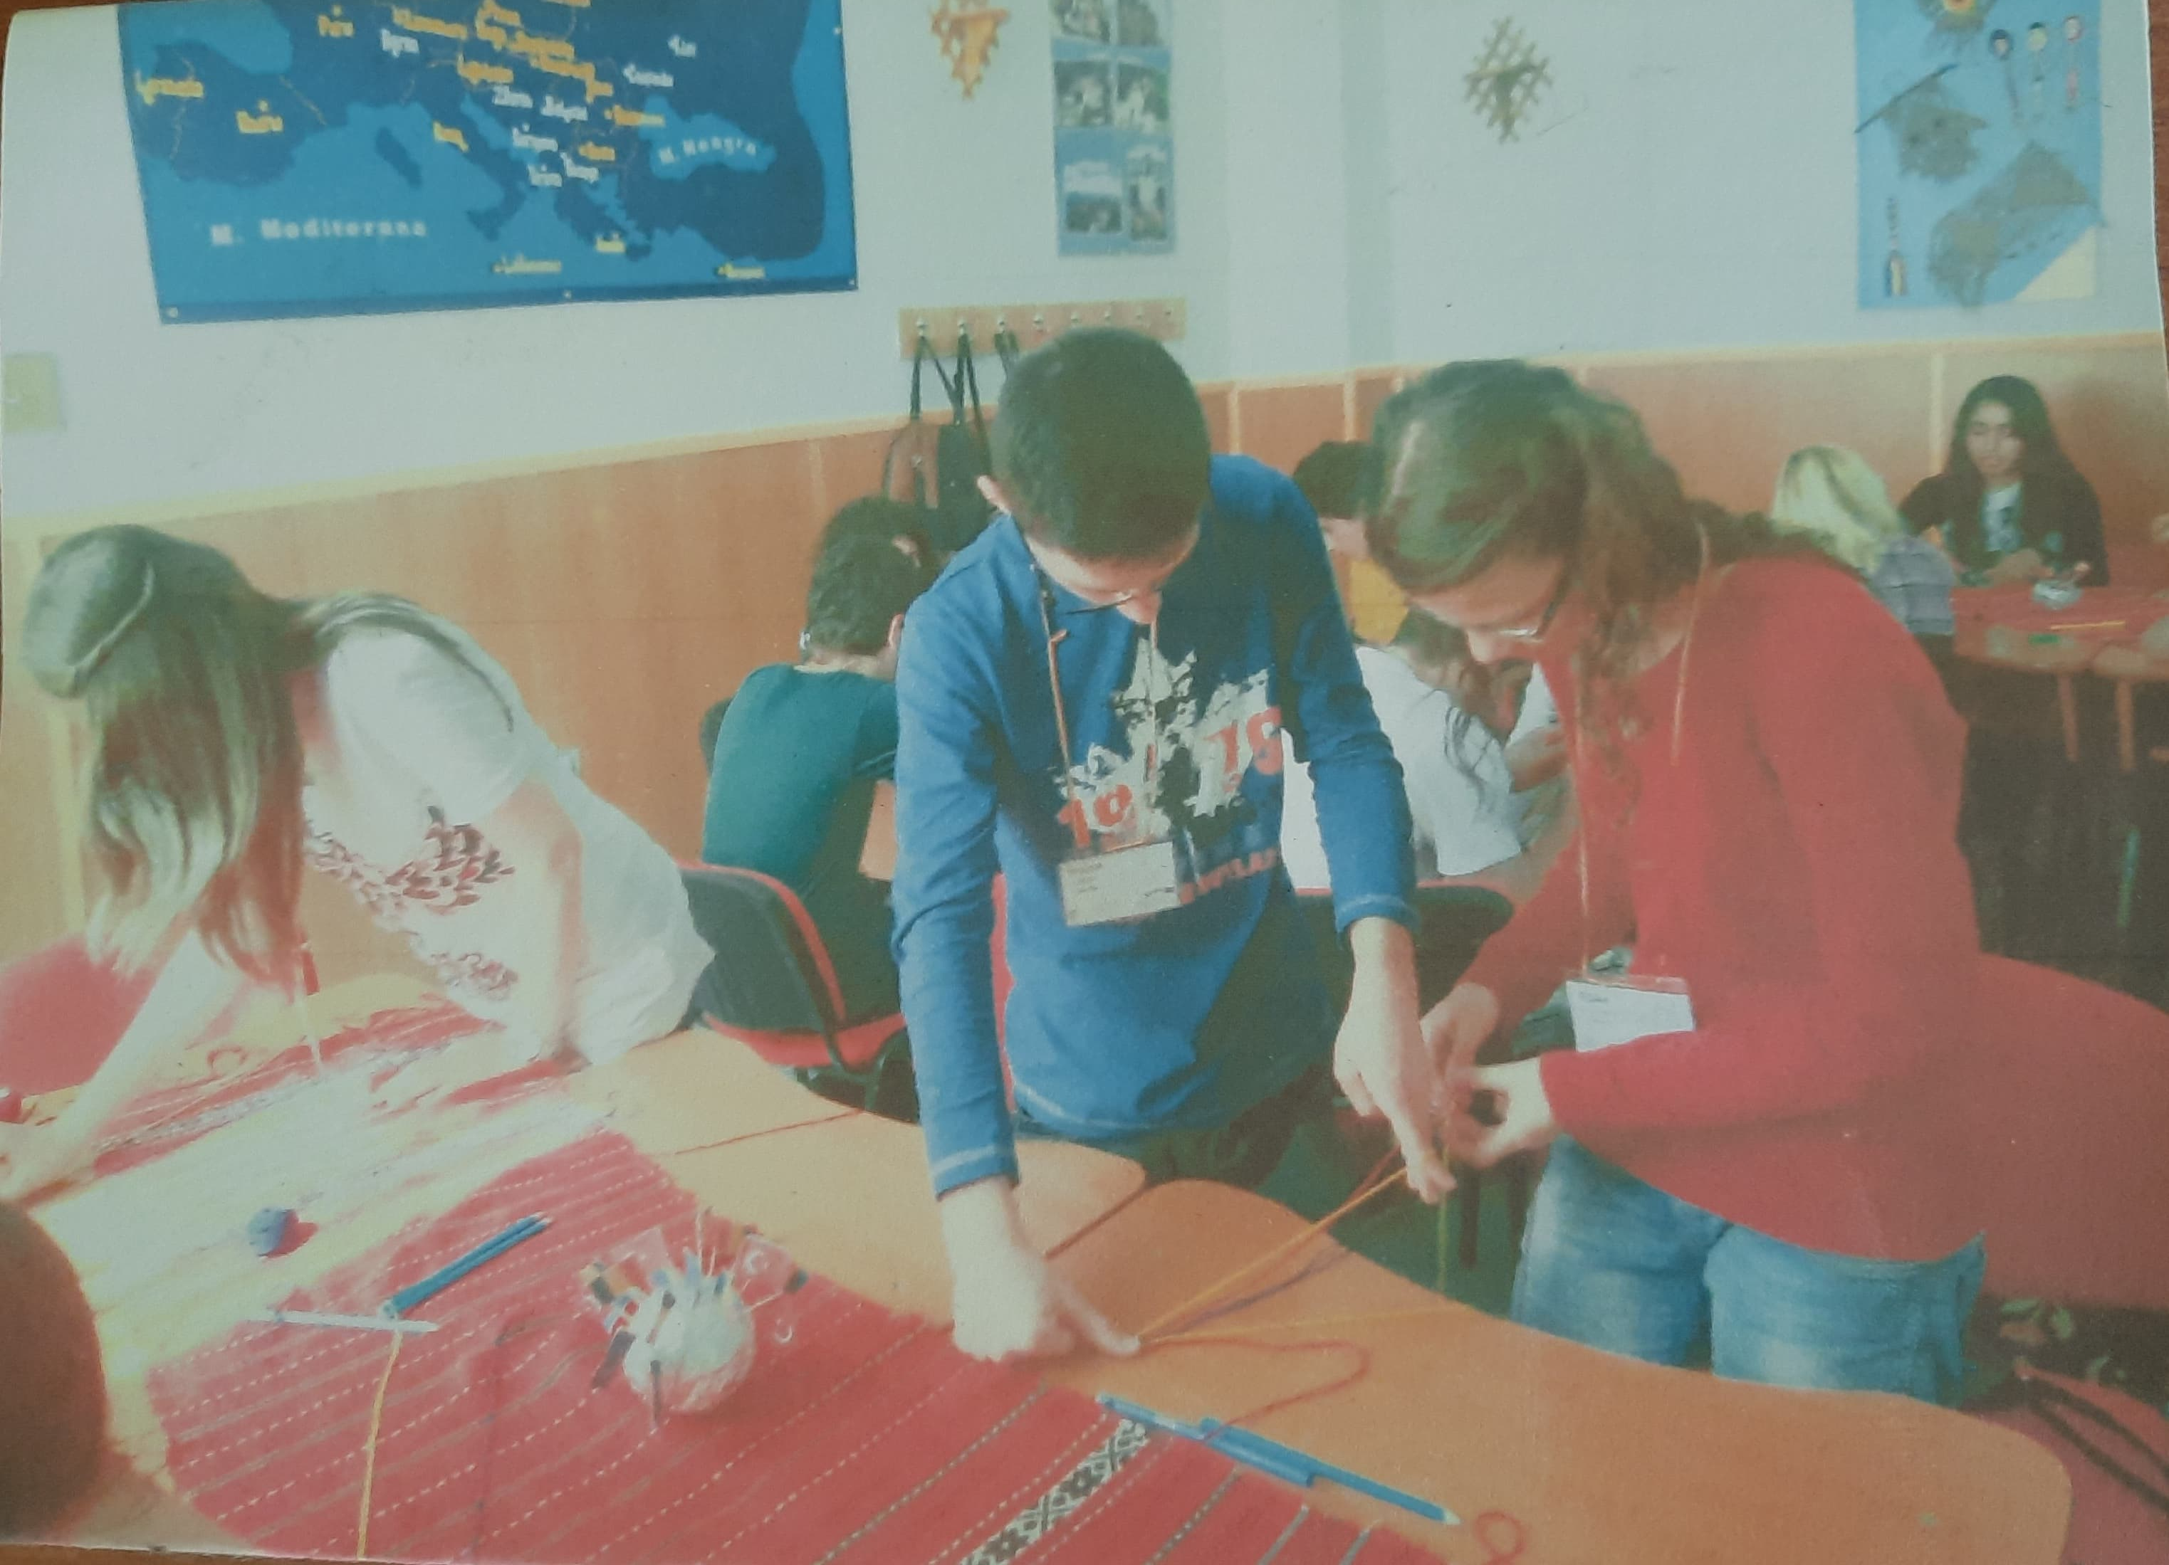
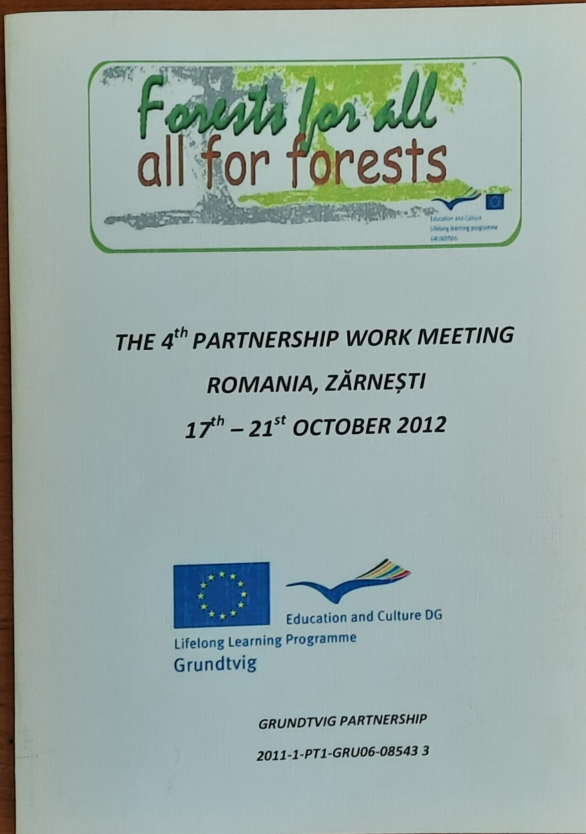
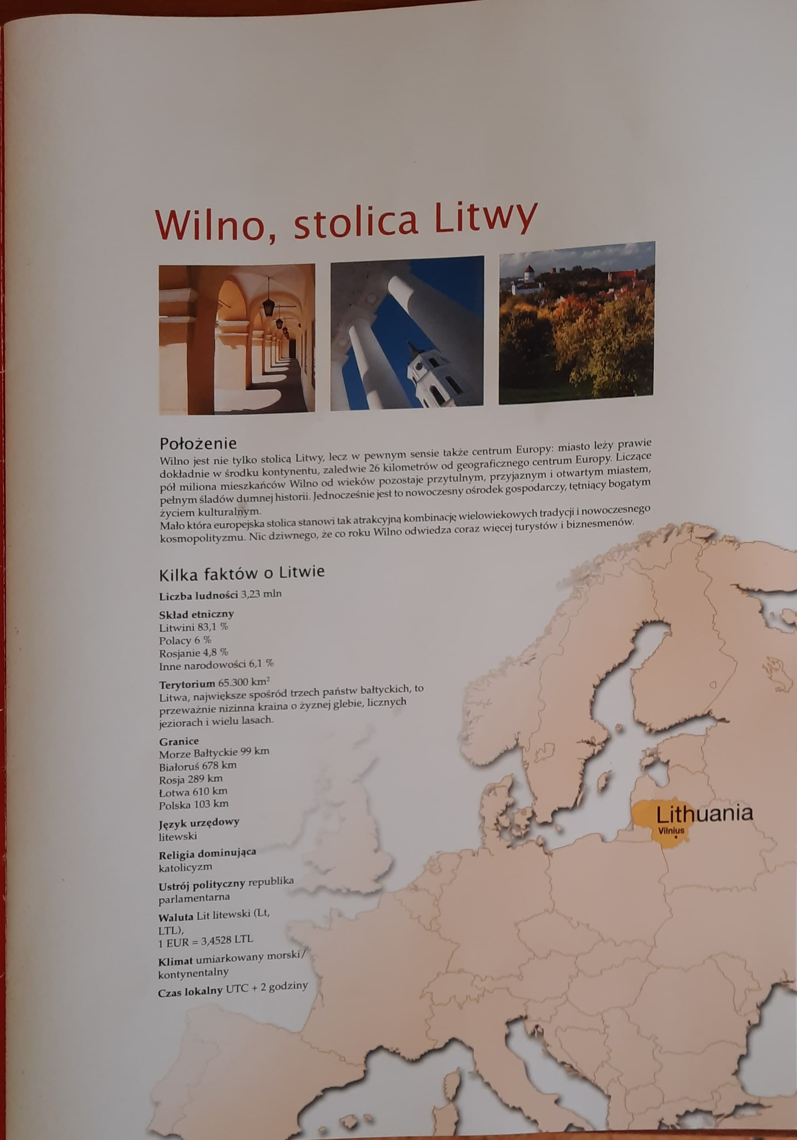
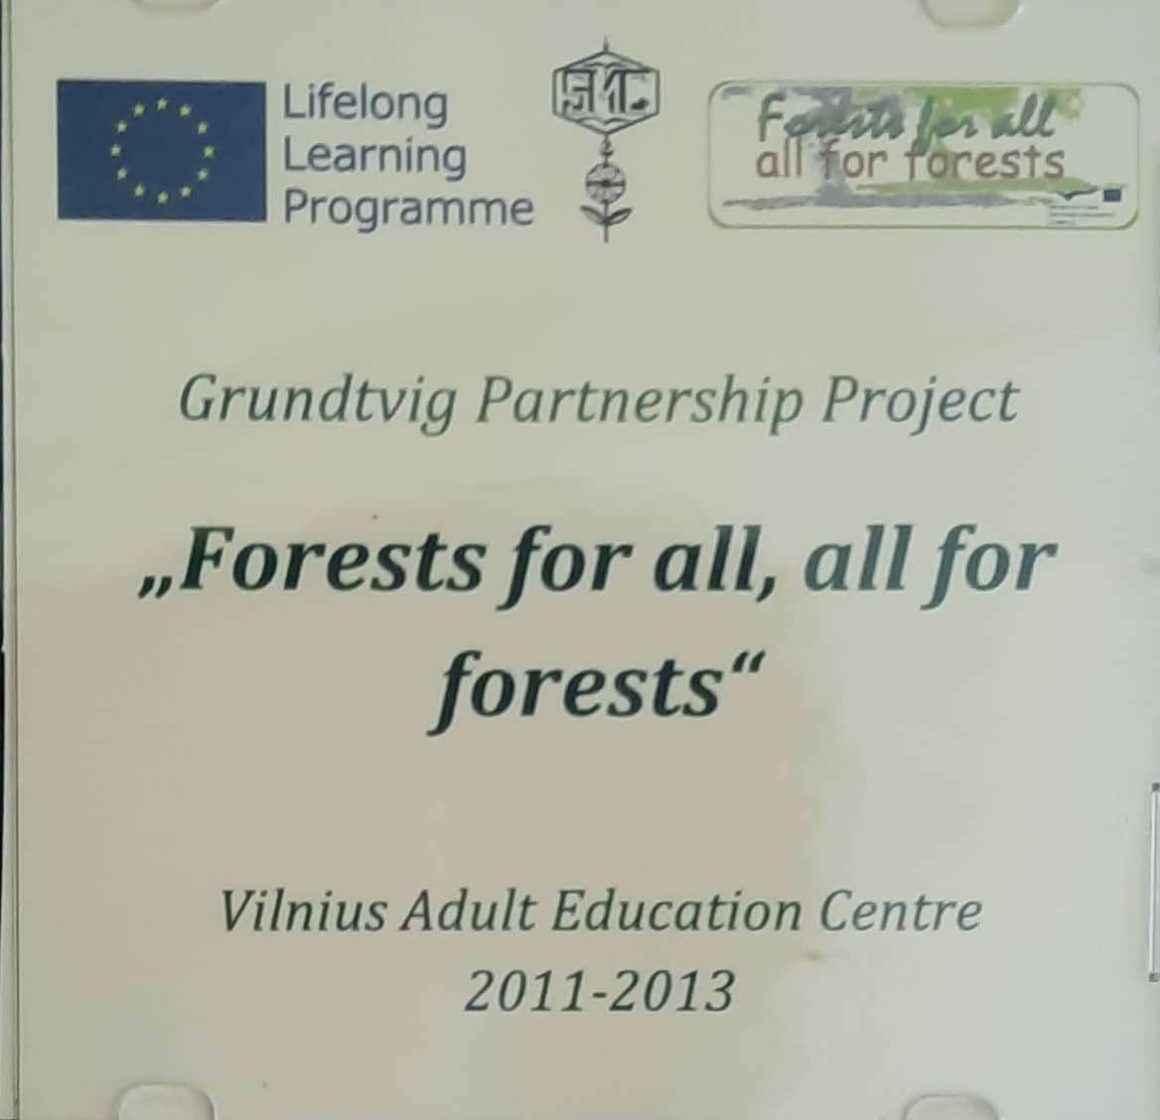
For 28 years since its establishment, the name of the school has been mentioned numerous times at local, county, national and international level.
Our school has developed partnerships with NGOs, high schools or university institutions, adult schools from Italy, Bulgaria, Turkey, Portugal, Poland, Lithuania and Great Britain.

Slide 5
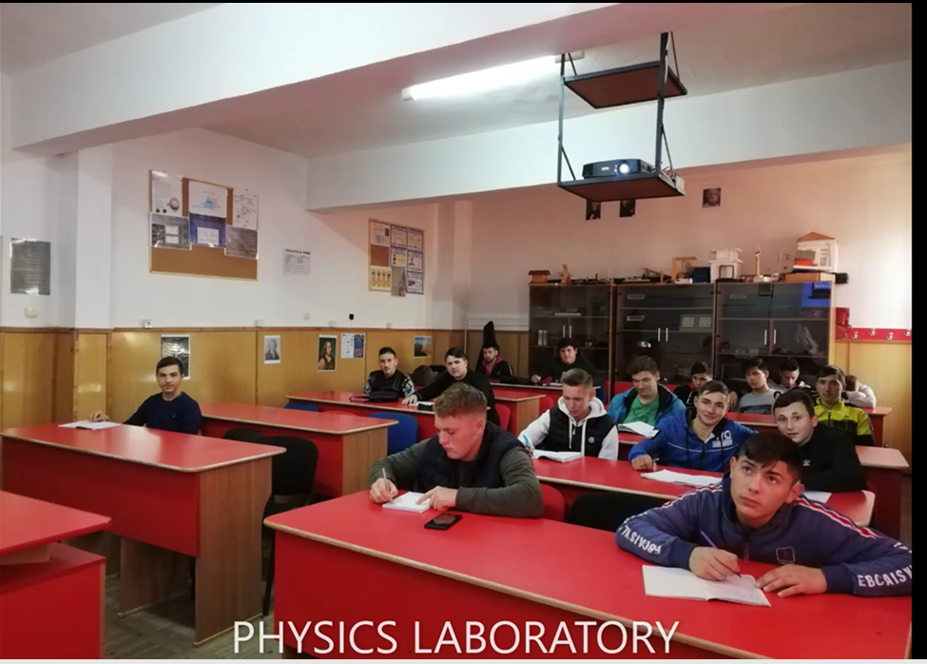
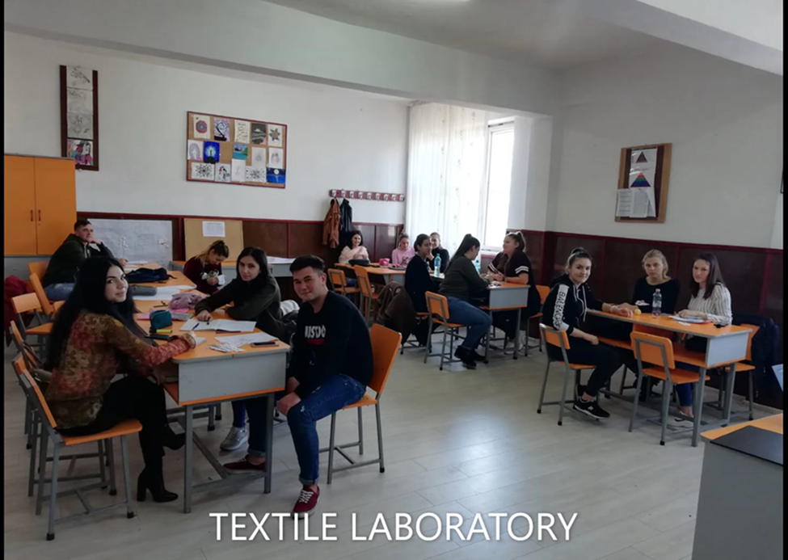
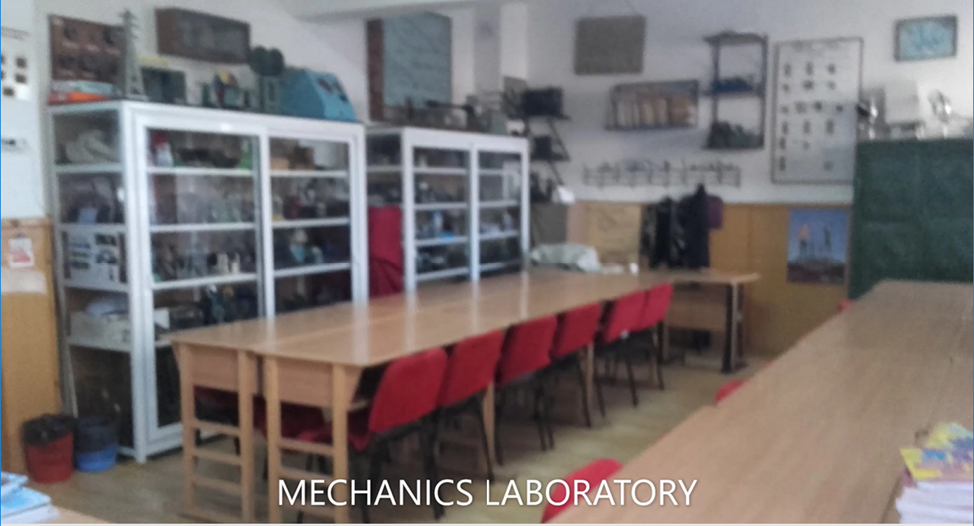
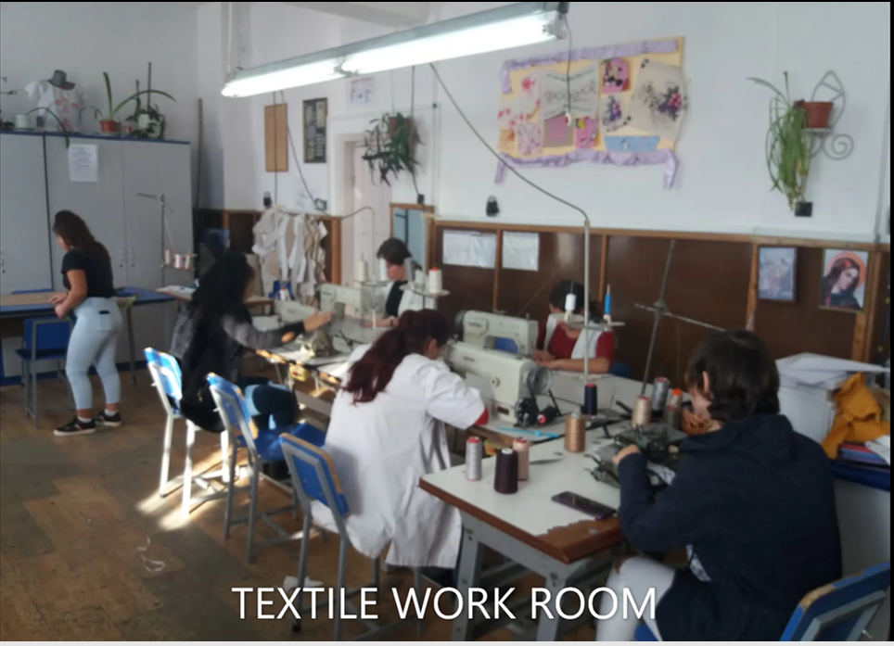
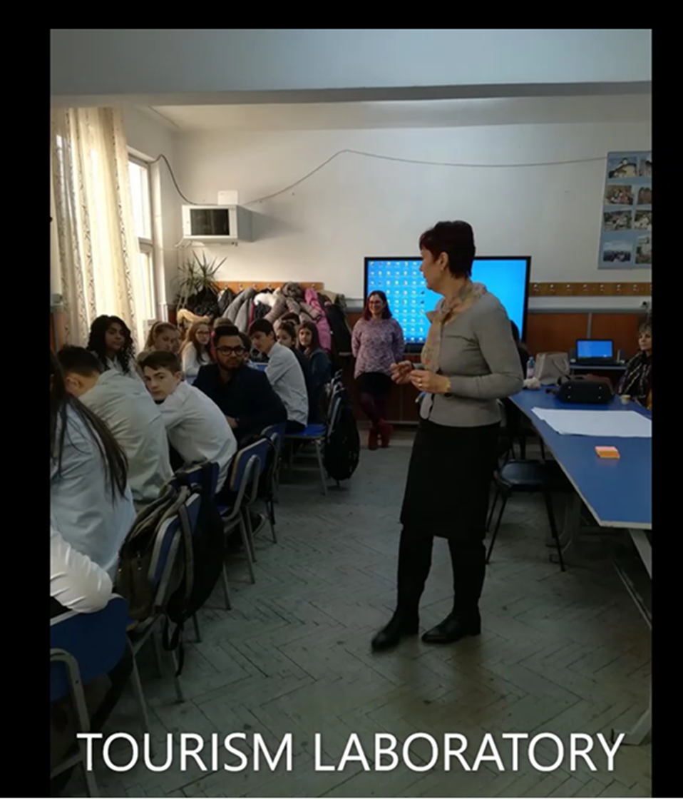
Our students learn and practise their qualifications in 15 classrooms, 6 laboratories, (for ICT, mechanical, textile, commerce, physics, tourism), and the workshops of the school (mechanics, textile, electromechanical).
Besides laboratories, the workshops of the school and medical offices, the High School also enjoys the existence the school’s library.

Slide 6
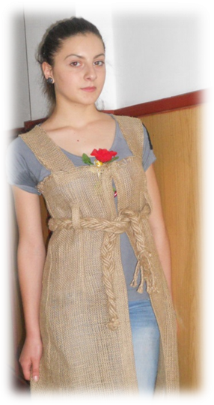
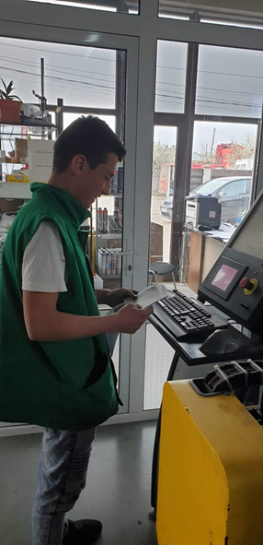
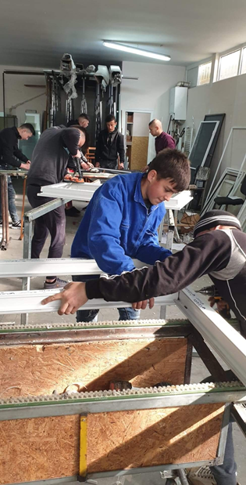
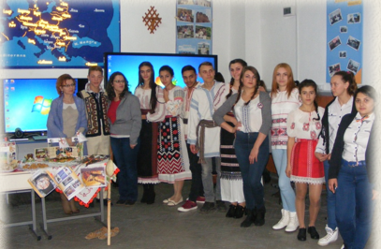
In the school year 2020-2021, at „Elena Caragiani” Technological High School, 867 students are enrolled and there are 64 teachers. Students can attend high school or vocational education courses.
High school education is organized on the following profiles:
1. Technical, with the following qualifications:
- Mechanical field: Maintenance and mechanical technician in maintenance and repairing, Electromechanical technician.
- Textile and leather domain: Clothes designer,
- Electrical field: Technician in electrical installations, Electrotechnist technician
2. Domain of services: Tourism technician.
3. Domain of commerce: Technician in acquisition and contracting.

Slide 7
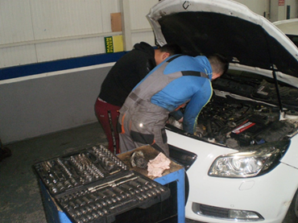
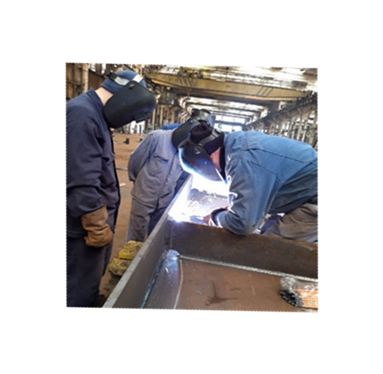
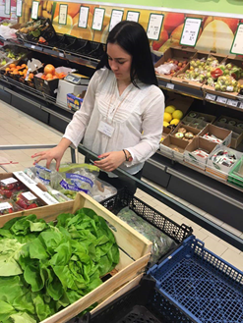
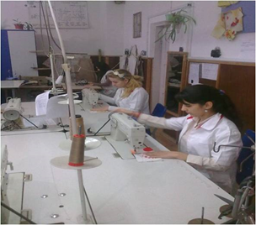
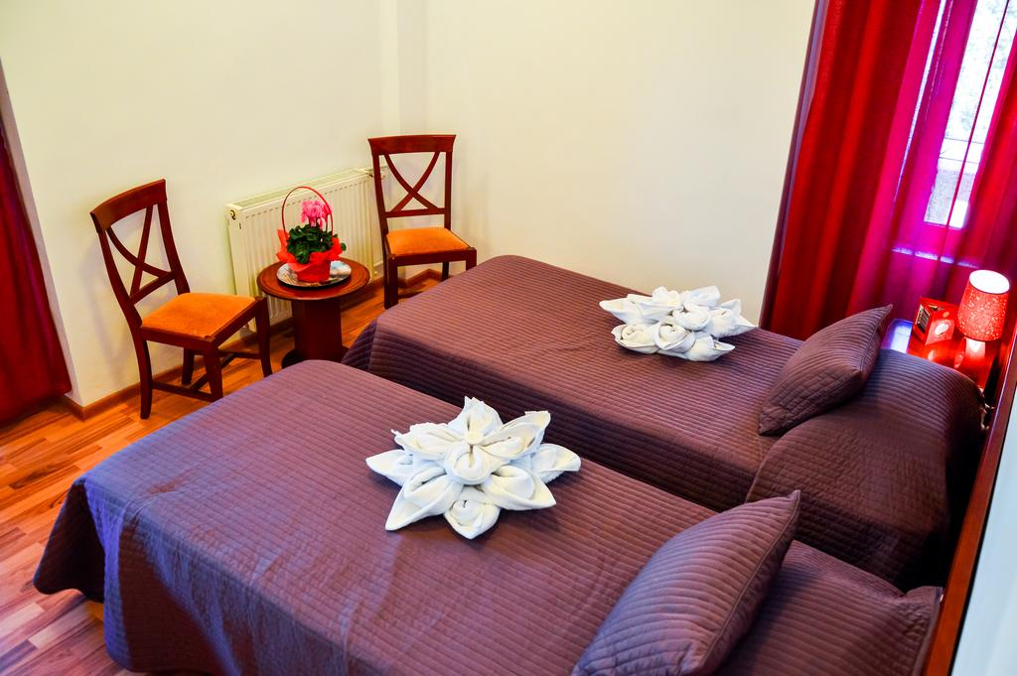
Vocational education courses is organized on the following profiles:
1. Technical, with the following qualifications:
- Mechanical field: Auto mechanic, Tinsmith auto painter, Operator on machines with numerical control, Welder
- Textile and leather domain: Manufacture of textile products
- Electrical field: Low voltage electrician, Electrician builder
2. Domain of services: Hotel worker
3. Domain of commerce: Seller trader

Slide 9
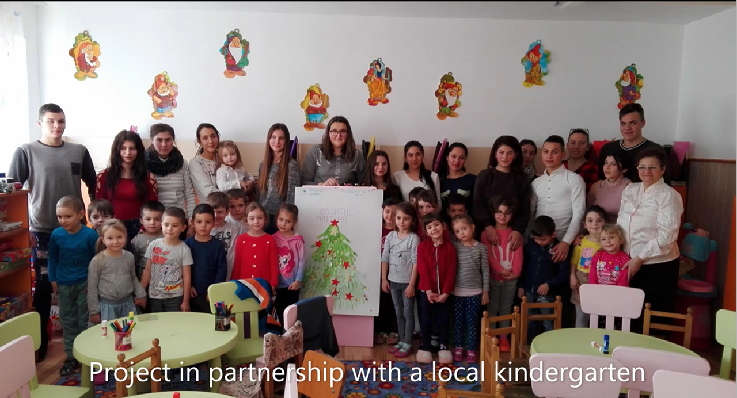

Slide 10
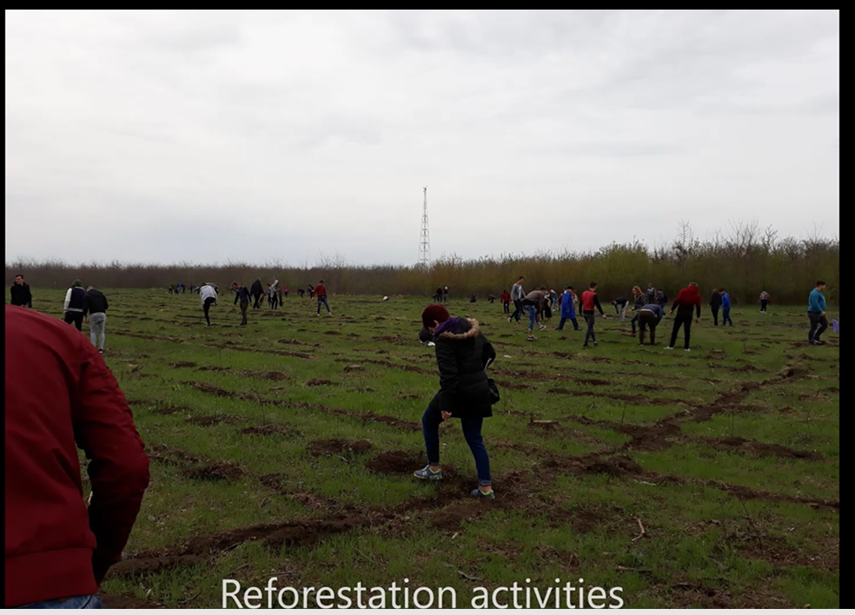

Slide 11
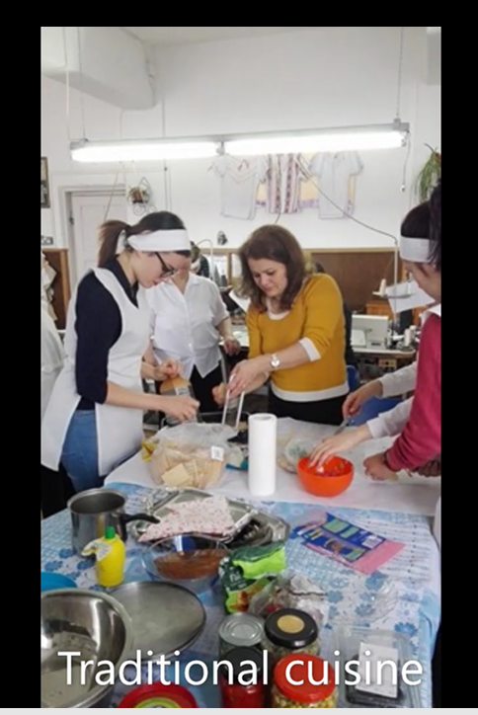

Slide 13
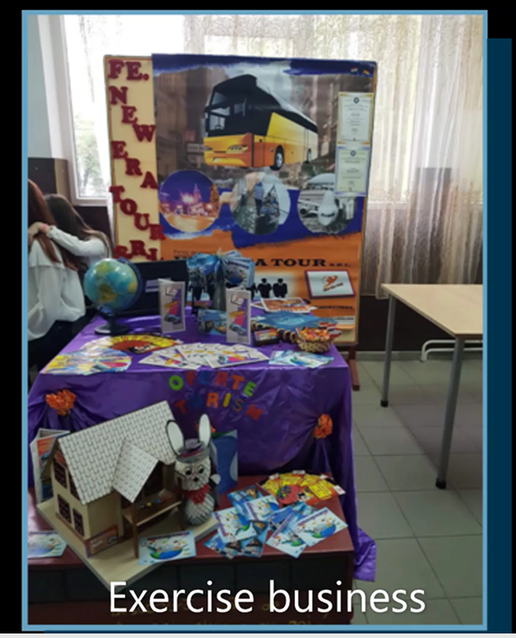

Slide 14
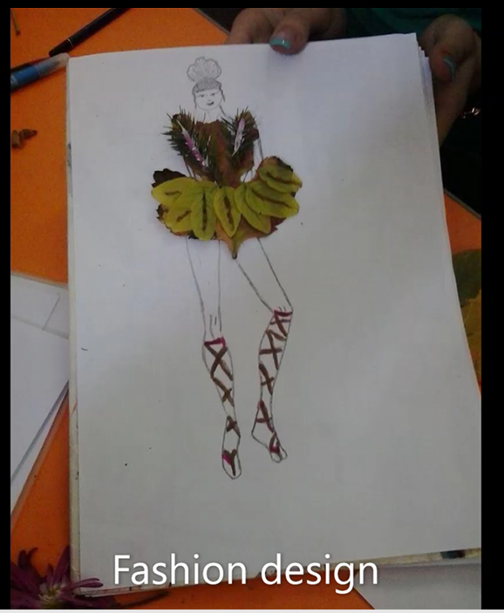

Slide 15
Thank you For your attention!

